Slide 1
Targeted screening and immediate start of treatment for acute HIV infection decreases time between HIV diagnosis and viral suppression among MSM at a Sexual Health Clinic in Amsterdam
M. Dijkstra, M.S. van Rooijen, M.M. Hillebregt, A.I. van Sighem, C. Smit, A. Hogewoning, T. Heijman, E. Hoornenborg, M. Prins, J.M. Prins, M.F. Schim van der Loeff, G.J. de Bree
On behalf of the H-TEAM initiative

Slide 2
Conflicts of interests
None to declare

Slide 3
Beneficial for patients
Reduces onward transmission
Insight into the potential for “post treatment control” interventions
Rapid diagnostic and referral trajectory for acute HIV infection among MSM at the Amsterdam STI clinic
Increase # acute HIV diagnoses, start ART within 24 hours
Lee Ebiomedicine 2016, Grijsen PLoS Med 2012, Powers Lancet 2011, Ananworanich PLOS One 2012

Slide 4
Objective
Evaluation of rapid acute HIV trajectory by comparing the trajectory with routine diagnostics and care, regarding:
Acute HIV diagnosis
Time from diagnosis to:
intake at HIV treatment centre
start ART
viral suppression

Slide 5
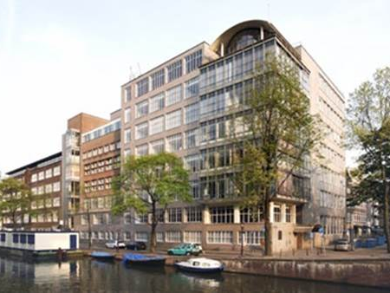
Rapid acute HIV trajectory, August 2015

Slide 6
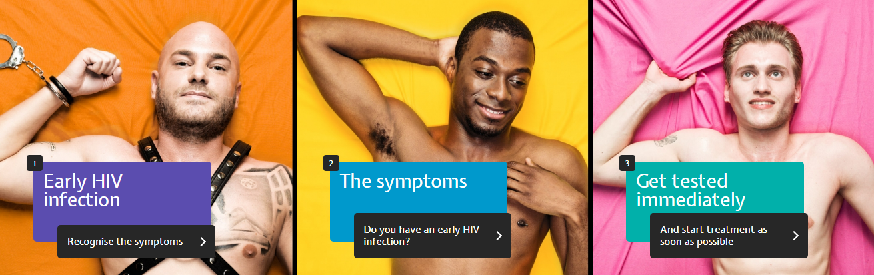
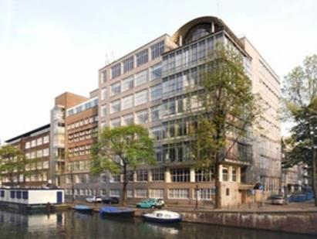
Rapid acute HIV trajectory, August 2015
Campaign¹
GP
Routine STI
Immediate
start of ART
Mass-media campaign
The Amsterdam
Score²
Point-of-care
HIV-RNA
1. www.hebikhiv.nl/en
2. Dijkstra BMC Infectious Diseases 2017, Lin JAIDS 2018

Slide 7
Methods - diagnosis
~22 days²
Routine testing
Rapid acute HIV trajectory
2008
Ab
If sick
Ag/Ab
HIV testing
strategy
2014
~17 days²
~10 days²
Universal Ag/Ab
2015
Universal Ag/Ab
Ab
Ag/Ab
Score¹
POC RNA
1. Dijkstra BMC Infectious Diseases 2017, Lin JAIDS 2018
2. Cohen NEJM 2011

Slide 8
Methods – ART initiation
Routine care
Rapid acute HIV trajectory
2008
CD4
<500
ART initiation
strategy
2012
CD4
<500
Acute
HIV
Data linkage between STI clinic and HIV treatment centres
2015
Immediate start
Universal start

Slide 9
Results - characteristics
19,728 MSM - 63,278 HIV testing visits 2008-2017
1,013 newly diagnosed with HIV
 | Acute HIV (Fiebig I-II) | Recent HIV (Fiebig III-V) | Chronic HIV (Fiebig VI) | Negative
n | 20 | 269 | 724 | 62,265
Age (years)* | 37 | 35 | 34 | 34
Days since last clinic visit* | 84 | 148 | 282 | 190
*Median

Slide 10
Rapid acute HIV trajectory, 2015-2017
127
26
98
33
HIV positivity rate
Trajectory: 7.6%
Routine: 0.7%
284
35
Acute HIV positivity rate
Trajectory: 4.0%
Routine: 0.03%
249
Acute HIV
Recent HIV
Chronic HIV
Negative
10
7
2
230

Slide 11
Results – acute HIV diagnosis
2008
n=768
2014
n=108
4.6%
2015-
2017
n=118
4.2%
2015-
2017
n=19
52.6%

Slide 12
Results – data linkage HIV treatment centres
665 / 1,013 records
 | Acute HIV (Fiebig I-II) | Recent HIV (Fiebig III-V) | Chronic HIV (Fiebig VI)
Viral load at intake (log10 copies/ml)* | 6.5 | 4.9 | 4.5
CD4 count at intake (cells/mm³)* | 440 | 520 | 460
CD4 nadir (cells/mm³)* | 425 | 400 | 360
*Median

Slide 13
Results – days to viral suppression
Days
2008
n=335
14
437
569
2012
n=223
13
99
228
2015-2017
n=72
Median days from HIV diagnosis to:
Universal start
9
29
95
2015-2017
n=15
1
1
55
Immediate start

Slide 14
Conclusions
Targeted screening resulted in a higher proportion of acute HIV infection than routine screening among MSM at the STI Clinic in Amsterdam
Implementation of a rapid acute HIV trajectory, along with changes in treatment guidelines, resulted in a shorter duration between HIV diagnosis and viral suppression

Slide 15
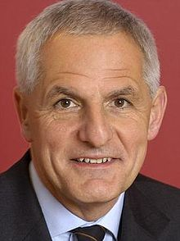
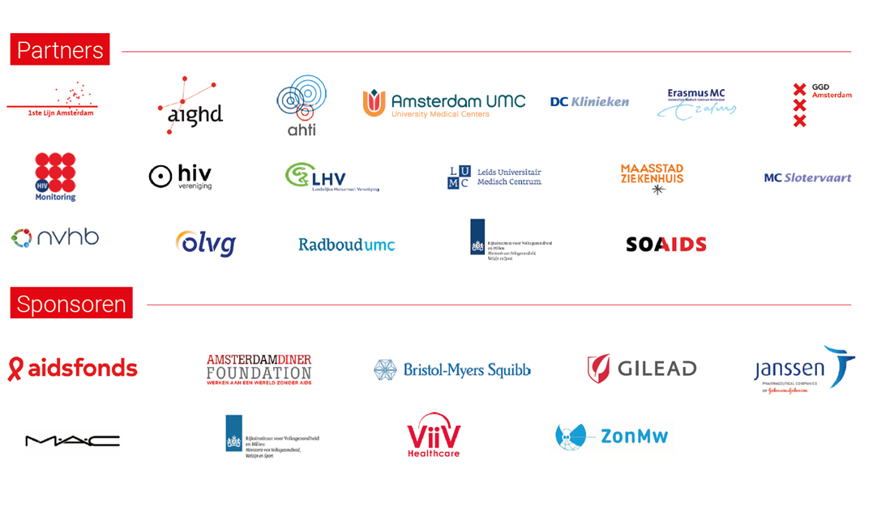
H-TEAM acknowledgements
Professor Joep Lange

Slide 16
Acknowledgements
www.hteam.nl
Marije Groot Bruinderink
Nina Schat
Peter Reiss
Arjan van Bijnen
Jan van Bergen
Wim Zuilhof
Sylvia Bruisten
Alje van Dam
Udi Davidovich
Arjan Hogewoning
Michelle Kroone
David Kwa
Dominique Loomans
Annebel Tahey
Linda May
Paul Oostvogel
Ineke Stolte
Gerben Rienk Visser
Dewi Usmany
Henry de Vries
Justin Luidens

Slide 17
Variables significantly associated with HIV seroconversion in Amsterdam Cohort Studies
 | Beta coefficient
Fever | 1.6
Lymphadenopathy | 1.5
Oral thrush | 1.7
Weight loss | 0.9
>5 sexual partners | 0.9
Gonorrhoea | 1.6
Receptive condomless anal intercourse | 1.1
→ Amsterdam score
Dijkstra BMC Infectious Diseases 2017, Lin JAIDS 2018

Slide 18
Amsterdam score
Cut-off | Sens % | Spec % | AUC
Development in Amsterdam Cohort Studies (NL)
1.5 | 76.3 | 76.3 | 0.82
Validation in Multicenter AIDS Cohort Study (USA)
1.5 | 56.0 | 88.5 | 0.78
Validation in San Diego Early Test Program (USA)
1.5 | 81.0 | 78.2 | 0.88
Dijkstra BMC Infectious Diseases 2017, Lin JAIDS 2018

